Slide 1
Coconut crop harvest mechanization for reducing harvest cost
PIP2001 Capstone Project
Review-0
Batch Number:
Roll Number | Student Name
20211ISR0017 | P L THIYAGARAJAN
20211ISR0034 | MADHUBALA S
20211ISR0011 | ADITYA M SUDAN
20211ISR0045 | B KRIPASHINI
20211ISR0028 | MERVYN CHRISTY J
Under the Supervision of,
Dr. AKSHATHA Y
Professor / Associate Professor / Assistant Professor
School of Computer Science and Engineering
Presidency University
Name of the Program: B.TECH
Name of the HoD: Dr.ZAFAR ALI KHAN
Name of the Program Project Coordinator: Dr. AFROZ PASHA
Name of the School Project Coordinators: Dr. Sampath A K / Dr. Abdul Khadar A / Mr. Md Ziaur Rahman

Slide 2
Content
Problem Statement
Github Link
Analysis of Problem Statement
Timeline of the Project
References

Slide 3
Problem Statement Number: PSCS51
Organization: Marico
Category (Hardware / Software / Both) : Hardware
Problem Description: More than 1/3rd of the coconut farm consists of labour expenses. The major heads for the same are harvesting charges. Harvesting requires skilled set of labours and shortage of labour leads to higher cost and delay in harvesting. Also the number of trees that can be harvested manually remains a constraint. Previous innovations in this field like the coconut climbing machine has had limited success because the speed of operation becomes slow and there is unwillingness of the farmer to be a climber himself. Hence the problem remains unsolved. What is needed :A harvesting machine/mechanization which can be directed/controlled easily from ground without needing farmer/labour to climb the tree. Expectations from said mechanization-1. Accurate cutting and harvesting ability 2. Cost benefit vs Manual climbing 3. Low effort required to activate and use
Difficulty Level: Complicated

Slide 4
Github Link
The Github link provided should have public access permission.
Github Link
https://github.com/Thiyag15/C-0-CONUT-harVESTER

Slide 5
Analysis of Problem Statement
Technology Stack Components:
Arduino Microcontroller
Motors
Sensors
Mechanical Harvesting Tools
Power Components
Communication Modules
Prototyping Tools
Arduino IDE
User Interface
Feedback and Safety Mechanisms
Automation and Decision Making

Slide 6
Analysis of Problem Statement (contd...)
Hardware Requirements:
Arduino Microcontroller
Arduino Board
Arduino Uno
Motor Drivers
L298N Motor Driver
Sensors
Ultrasonic Sensors
Infrared (IR) Sensors
Communication Modules
RF Transceivers
Bluetooth Modules
Relays and Switches
Relay Modules
MOSFETs

Slide 7
Analysis of Problem Statement (contd...)
Software requirements
Arduino IDE
Programming Environment
C/C++ Programming Language
Control Algorithms
Motor Control Algorithms
PID Control
PWM Control
Feedback and Safety Mechanisms
Error Detection
Simulation and Testing Tools
Tinker CAD

Slide 8
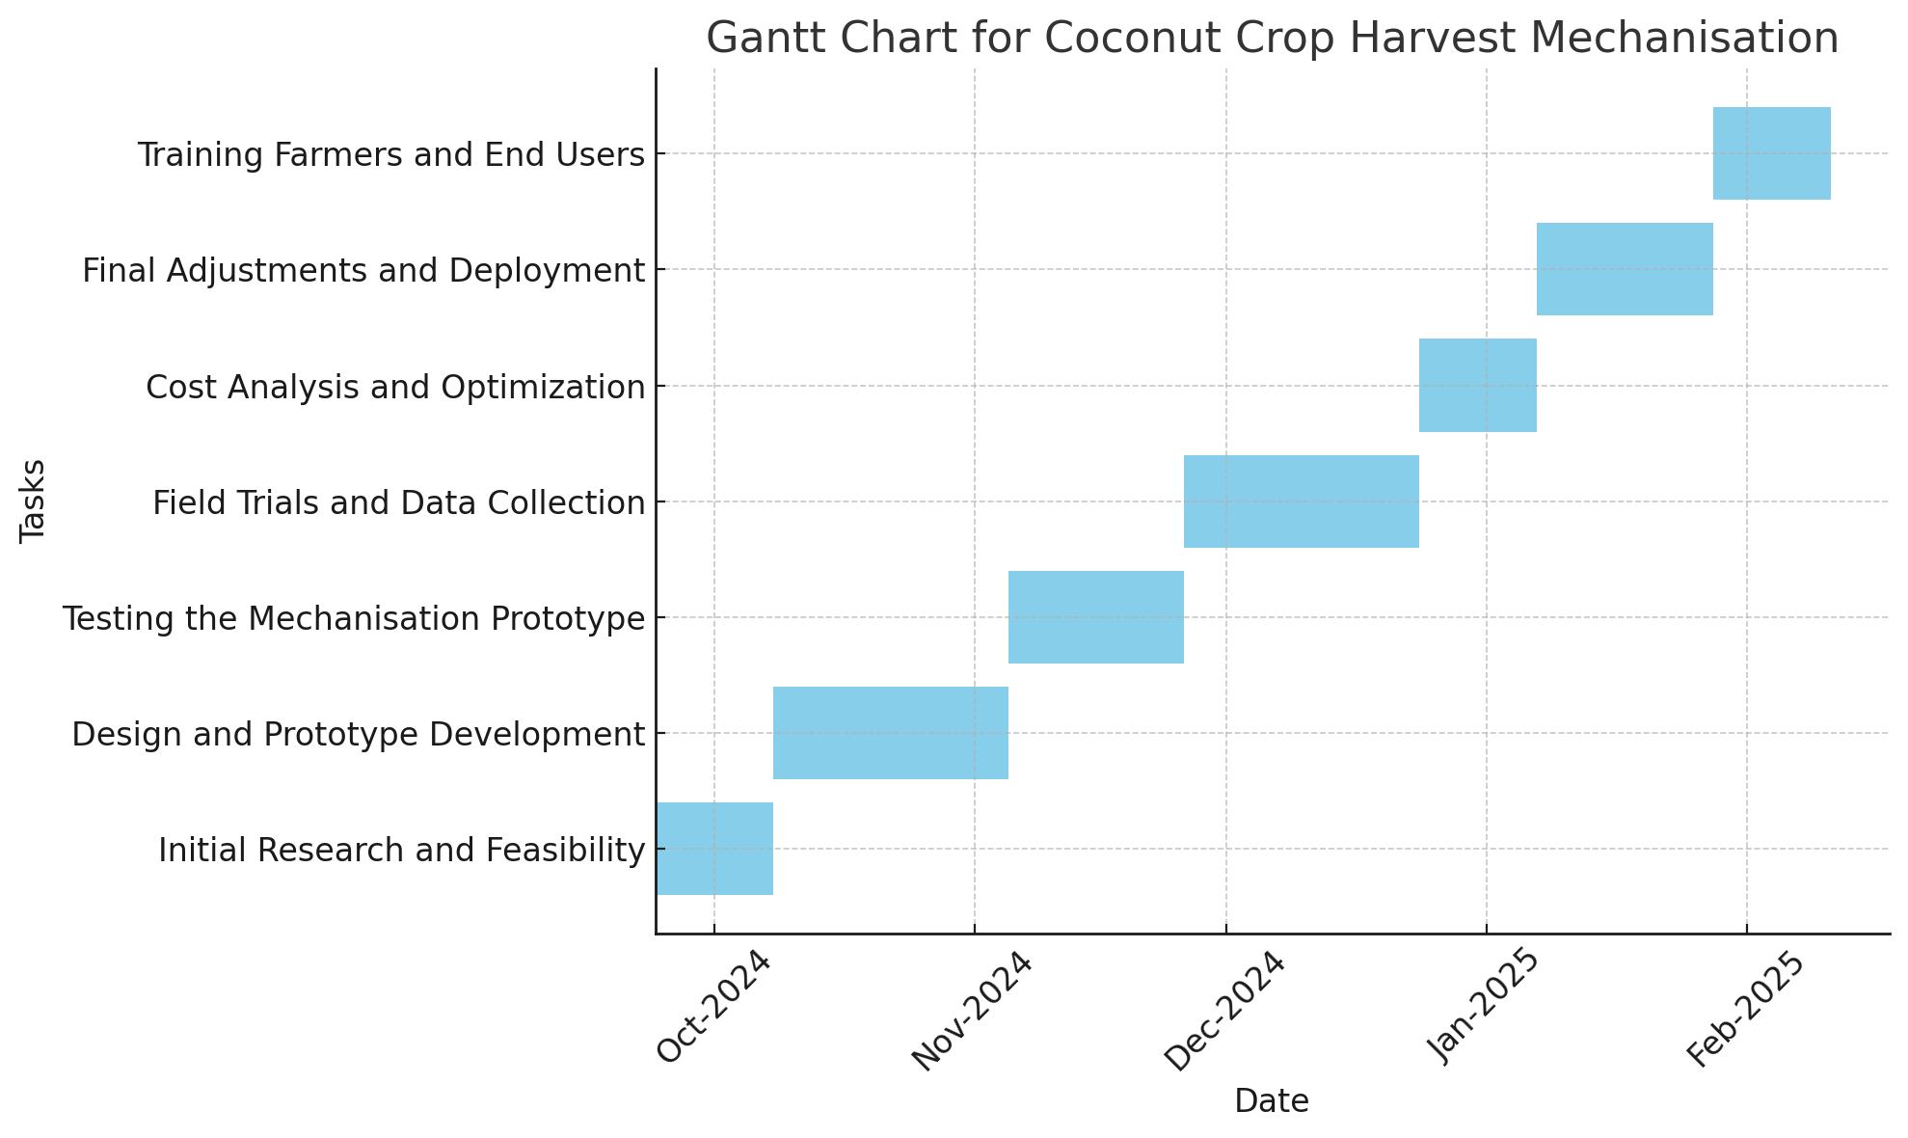
Timeline of the Project (Gantt Chart)

Slide 9
References (IEEE Paper format)
Add APA Citation for all references.
Use the below link for various APA styles :
https://ieeexplore.ieee.org/document/10157666

Slide 10


